Slide 1



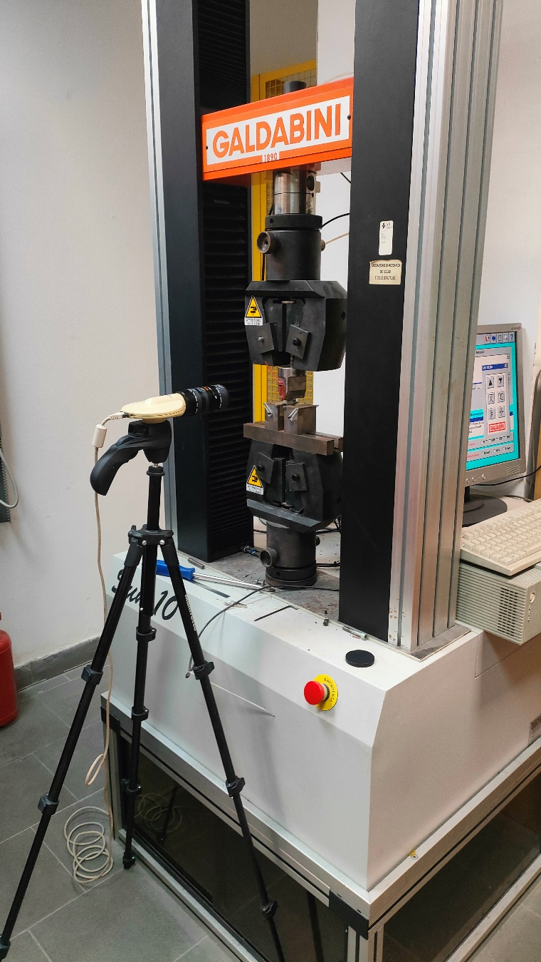
MEMBER OF
UNIVERSITY
OF CASSINO AND SOUTHERN LAZIO
Fourth Blended Intensive Program on
Material Modeling – Testing and Parameter Identification
Spring semester 2026
University of Cassino and Southern Lazio
Department of Civil and Mechanical Engineering

Slide 2
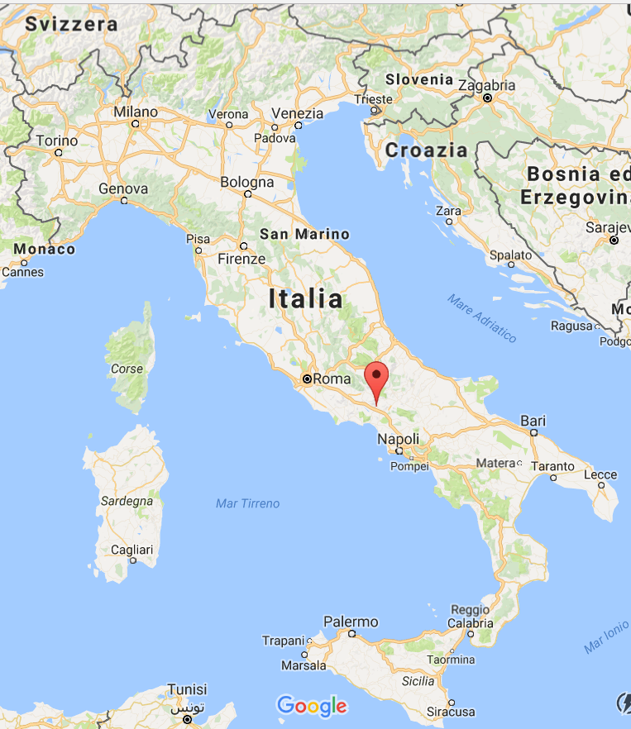
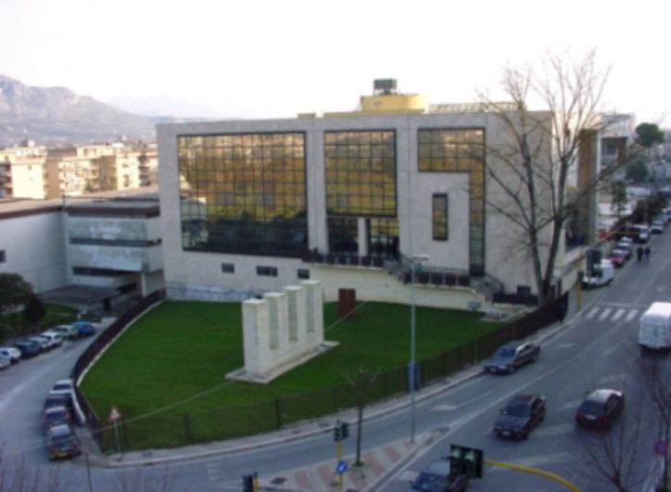
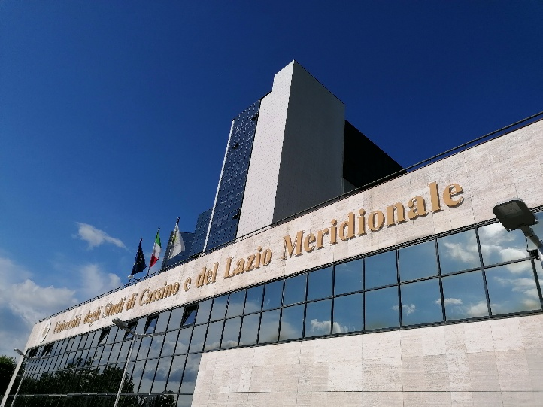
University presentation
General information
The University of Cassino and Southern Lazio is a public institution founded in 1979.
Unicas is made of 5 Departments:
Economics and Law
Civil and Mechanical Engineering
Electrical and Information Engineering
Human Arts and Philosophy Human, Society and Health Sciences
Unicas offers
14 Bachelor’s degree courses in Italian
2 Bachelor’s degree courses in English
18 Master’s degree courses in Italian
5 Master’s degree courses in English

Slide 3
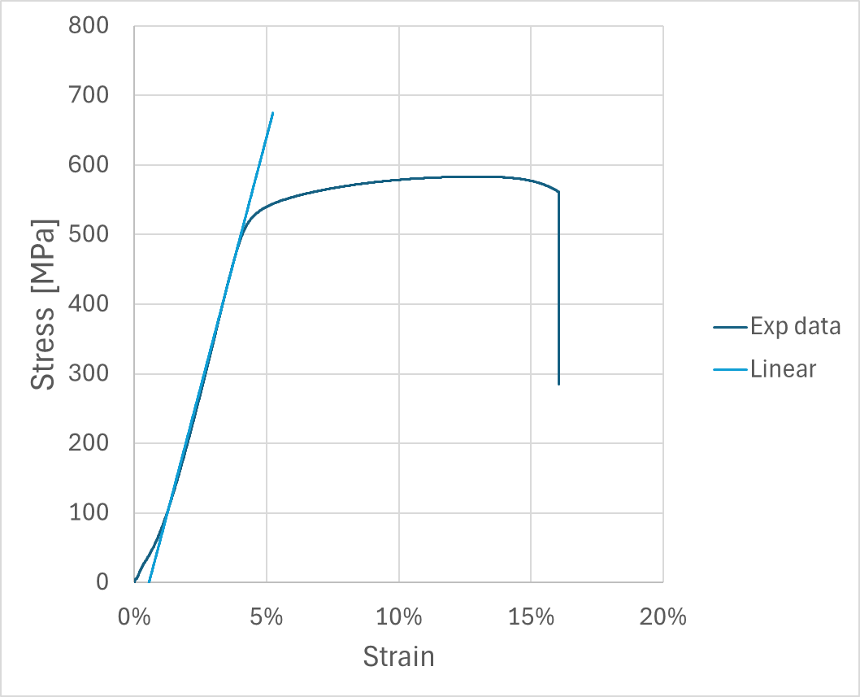
Material modelling
Material Modelling is the process of creating and utilizing mathematical models (often expressed through constitutive equations) that describe the mechanical, physical, and/or chemical behavior of engineering materials.
These models are essential for:
Prediction: Forecasting a material's response (e.g., stress, strain, deformation, failure) under various operational and environmental conditions (temperature, load rate, etc.).
Simulation: Integrating the material properties into numerical analysis tools, most notably the Finite Element Method (FEM), to simulate and optimize complex engineering structures and products.
Design: Providing the necessary input for engineers to select the right material, define safe operating limits, and ensure the structural integrity of components.
Material modelling forms a crucial loop with testing: testing provides the data to calibrate (Parameter Identification) the mathematical Models, which are then used for Simulation.

Slide 4
Study course
For BA and MA students of engineering, e.g. mechanical engineering, civil engineering, plastics engineering, industrial engineering; PhD students upon request.
PHASE | DATES | DETAILS
ONLINE LECTURES | FROM 09-03-2026 TO 15-06-2026 | Each Monday for 90 min 17:00 - 18:30 (CET)
INTENSIVE WEEK IN CASSINO | FROM 29-06-2026 TO 03-07-2026 | On-site activities, Labs, and/or Field Trips
6 ECTS will be granted.
Finances & Costs
Travel and accommodation costs need to be covered by the Erasmus+ scholarship provided by the sending institution.
Activities carried out in Cassino will be offered by UNICAS.
No fees for the BIP will be charged.
Language: English
Evaluation: homework, technical report, final presentation, exam
Minimum of 15 international participants

Slide 5
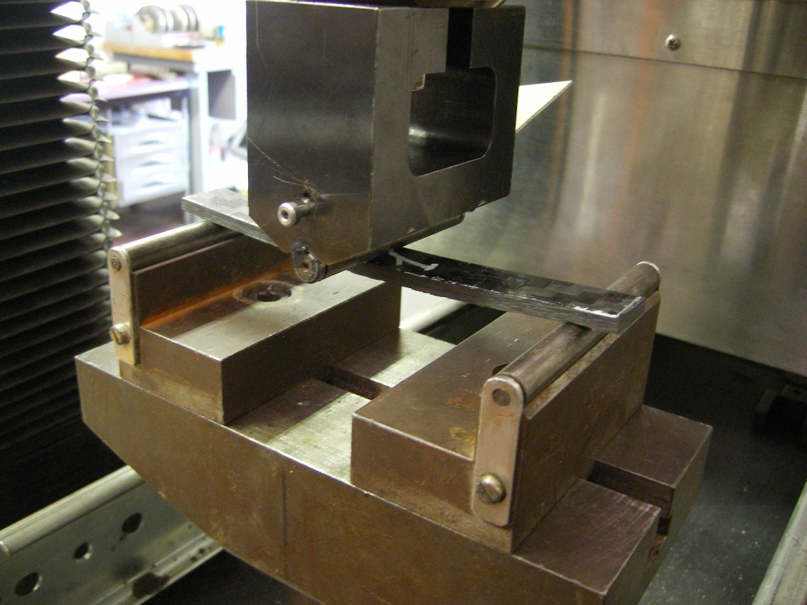
Online lectures
No. | Date | Topic
1 | 09.03 | Preliminary meeting – Organization of the course Introduction to Material Modelling – Testing and Parameter Identification 1.1. Motivation of the course 1.2. Numerical analysis of components and structures
2 | 16.03 | Classification of Materials and Loading
3 | 23.03 | Material Properties and Structure of Materials 3.1 Strength and deformability 3.2 Material properties at static and dynamic loading 3.3 Material properties at cyclic loading
4 | 30.03 | Experimental Testing of Materials 4.1 Testing methods 4.2 Standard tests 4.3 Non-standard tests
 | 06.04 | Catholic Easter (Holiday)
5 | 13.04 | Base Material Models and Parameters 5.1 Introduction to Python 5.2 Elasticity
6 | 20.04 | Base Material Models and Parameters 6.1 Viscoelasticity 6.2 Elastoplasticity 6.3 Viscoplasticity
7 | 27.04 | Material Modelling and Parameter Identification 7.1 Strategies for parameter identification 7.2 Selection of material models
8 | 04.05 | FEM and Parameter Identification 8.1 Material models in FEM program 8.2 Examples
9 | 11.05 | Application to different Materials 9.1 Fabrics 9.2 Composites
10 | 18.05 | 9.3 Metals I 9.4 Wood and plywood
 | 25.05 | Catholic Pentecost (Holiday)
11 | 01.06 | 9.5 Plastics 9.6 Glass 9.7 Bones
12 | 08.06 | 9.8 Textile
13 | 15.06 | 10. Summary and Outlook, Preparation for intensive week

Slide 6
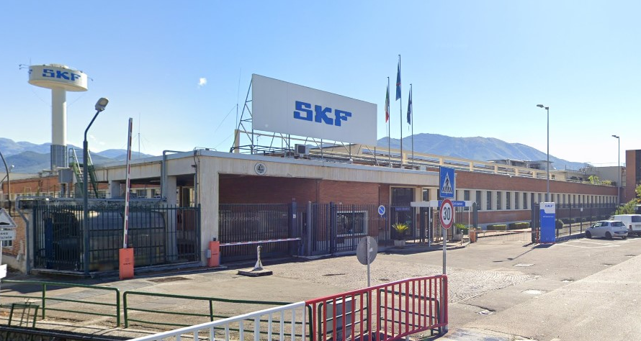
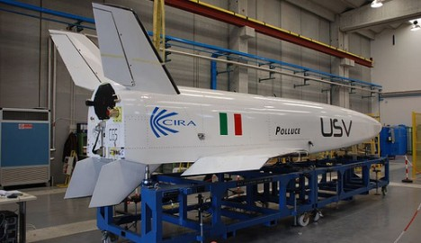
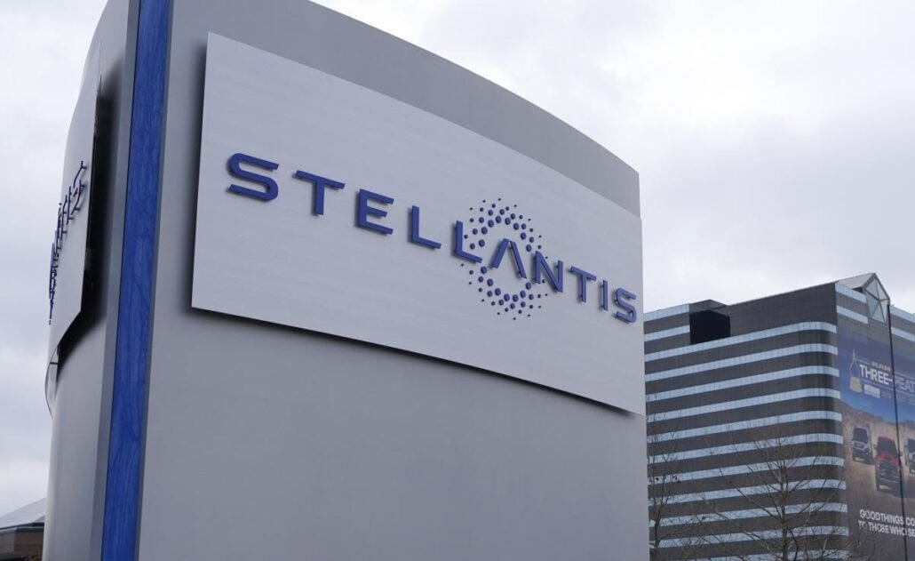
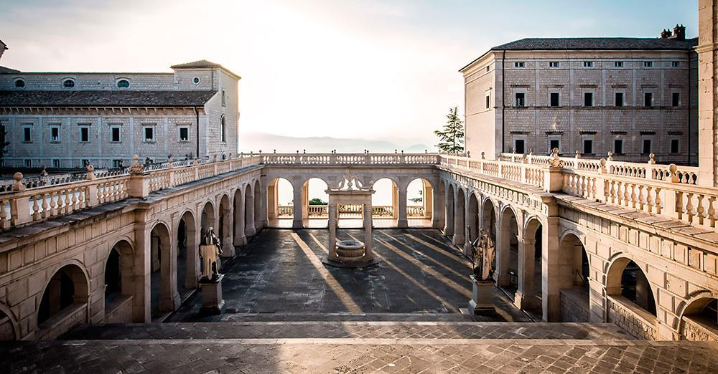
Intensive week
Experimental testing @ UNICAS Laboratories: static and dynamic tests with metals, plastics, additive manufactured materials, composites, etc.
Presentation of UNICAS + visits at laboratories and research facilities in the mechanical field
Excursions (suggestions)
CIRA – Italian Aerospace Research Centre
Stellantis plant
SKF plant
Montecassino abbey
Social event
FROM 29-06-2026 TO 03-07-2026

Slide 7
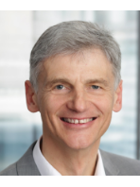
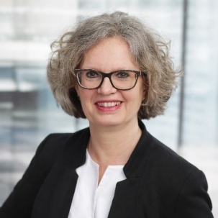


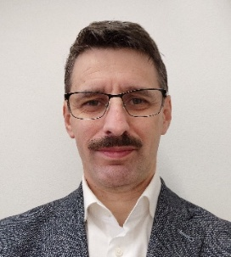
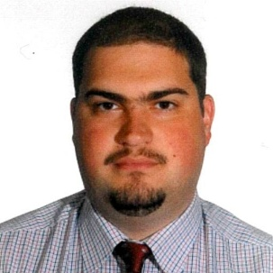

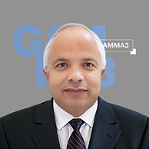
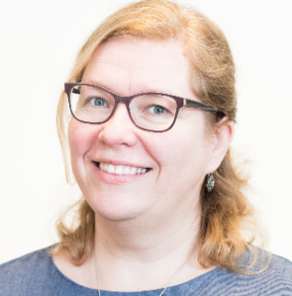


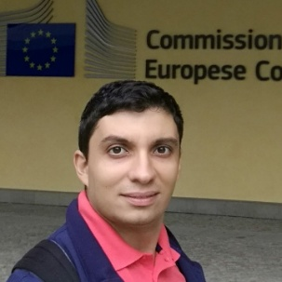

Teaching team
Prof.PhD.Eng. Thomas PYTTEL
thomas.pyttel@m.thm.de
Technische Hochschule Mittelhessen
Prof.PhD.Eng. Brita PYTTEL
brita.pyttel@h-da.de
Hochschule Darmstadt
Prof.PhD.Eng. Cristian DUDESCU
mircea.dudescu@rezi.utcluj.ro
Technical University of Cluj-Napoca
Lect.PhD.Eng. Radu CHIOREAN
radu.chiorean@rezi.utcluj.ro
Technical University of Cluj-Napoca
Prof.PhD.Eng. Abel CHEROUAT
abel.cherouat@utt.fr
University of Technology of Troyes
Prof.Dr.sc.ing. Inga Dabolina
inga.dabolina@rtu.lv
Riga Technical University
Ass.Prof.PhD.Eng. Costanzo BELLINI
costanzo.bellini@unicas.it
University of Cassino and Southern Lazio

Slide 8
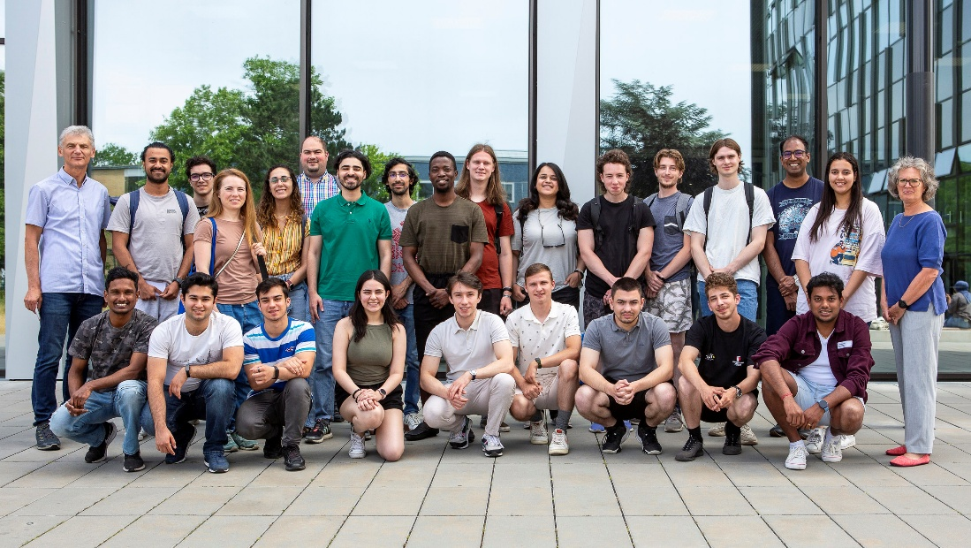
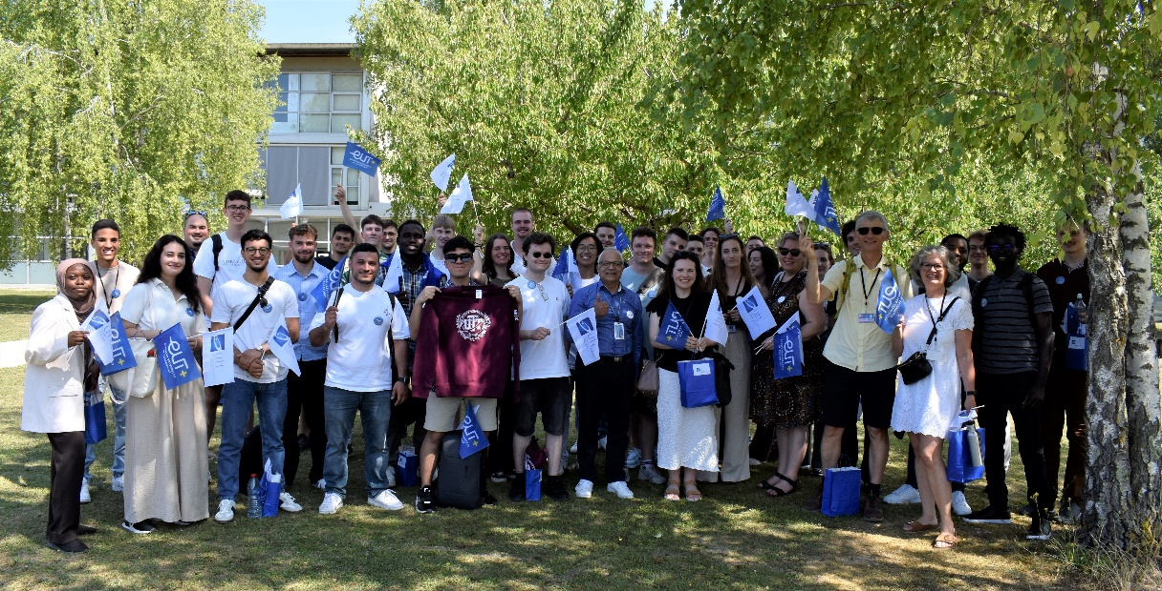
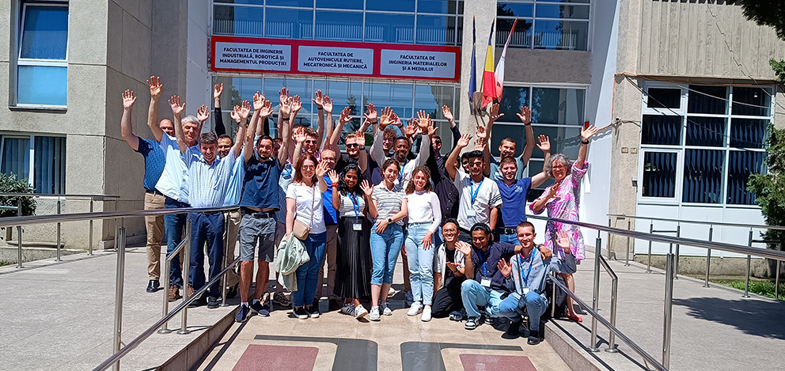
Previous Editions at a Glance
The first edition of this course was organized from the 26th to the 30th of June 2023 at Hochschule Darmstadt (https://impact.h-da.de/en/eut-bip)
The second edition of this course was organized from the 01st to the 05th of July 2024 at Technical University of Cluj-Napoca (https://www.univ-tech.eu/blended-intensive-program)
The third edition of this course was organised from the 30th of June to the 04th of July 2025 at Université de Technologie de Troyes (UTT)

