Slide 1


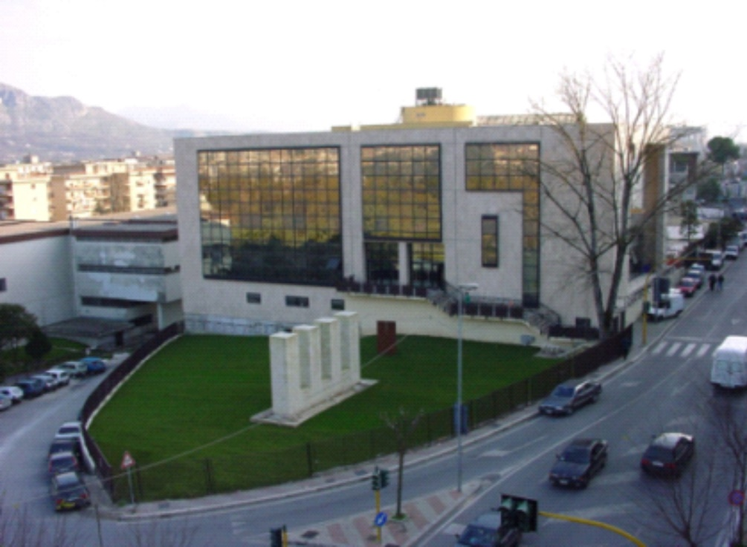
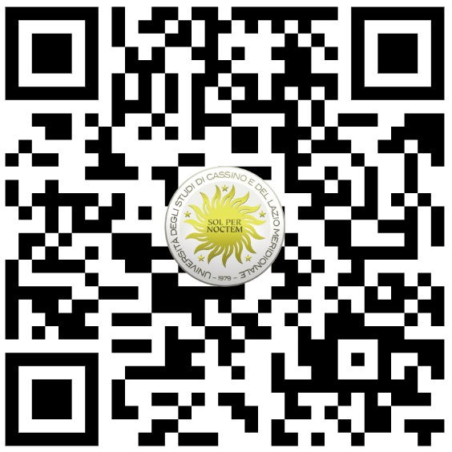
UNIVERSITY
OF CASSINO AND SOUTHERN LAZIO
MEMBER OF
Studying with a European perspective and experiencing the practice abroad?
Join the 4th edition of the Blended Intensive Programme (BIP) on “Material Modelling - Testing and Parameter Identification”
For BA and MA students of engineering, e.g. mechanical engineering, civil engineering, plastics engineering, industrial engineering; PhD students upon request. 6 ECTS will be granted.
PHASE | DATES | DETAILS
ONLINE LECTURES | FROM 09-03-2026 TO 15-06-2026 | Each Monday for 90 min 17:00 - 18:30 (CET)
INTENSIVE WEEK IN CASSINO | FROM 29-06-2026 TO 03-07-2026 | On-site activities, Labs, and/or Field Trips
Finances & Costs
Travel and accommodation costs need to be covered by the Erasmus+ scholarship provided by the sending institution.
Activities carried out in Cassino will be offered by UNICAS.
No fees for the BIP will be charged.
Apply here:
QR
More info about UNICAS:

